Slide 1

Digital Twin Forest
Group 8
Supervisor: Dr. Gonsamo
Yichen Jiang
Bowen Zhang
Jiacheng Wu
Junhong Chen
Tingyu Shi

Slide 2

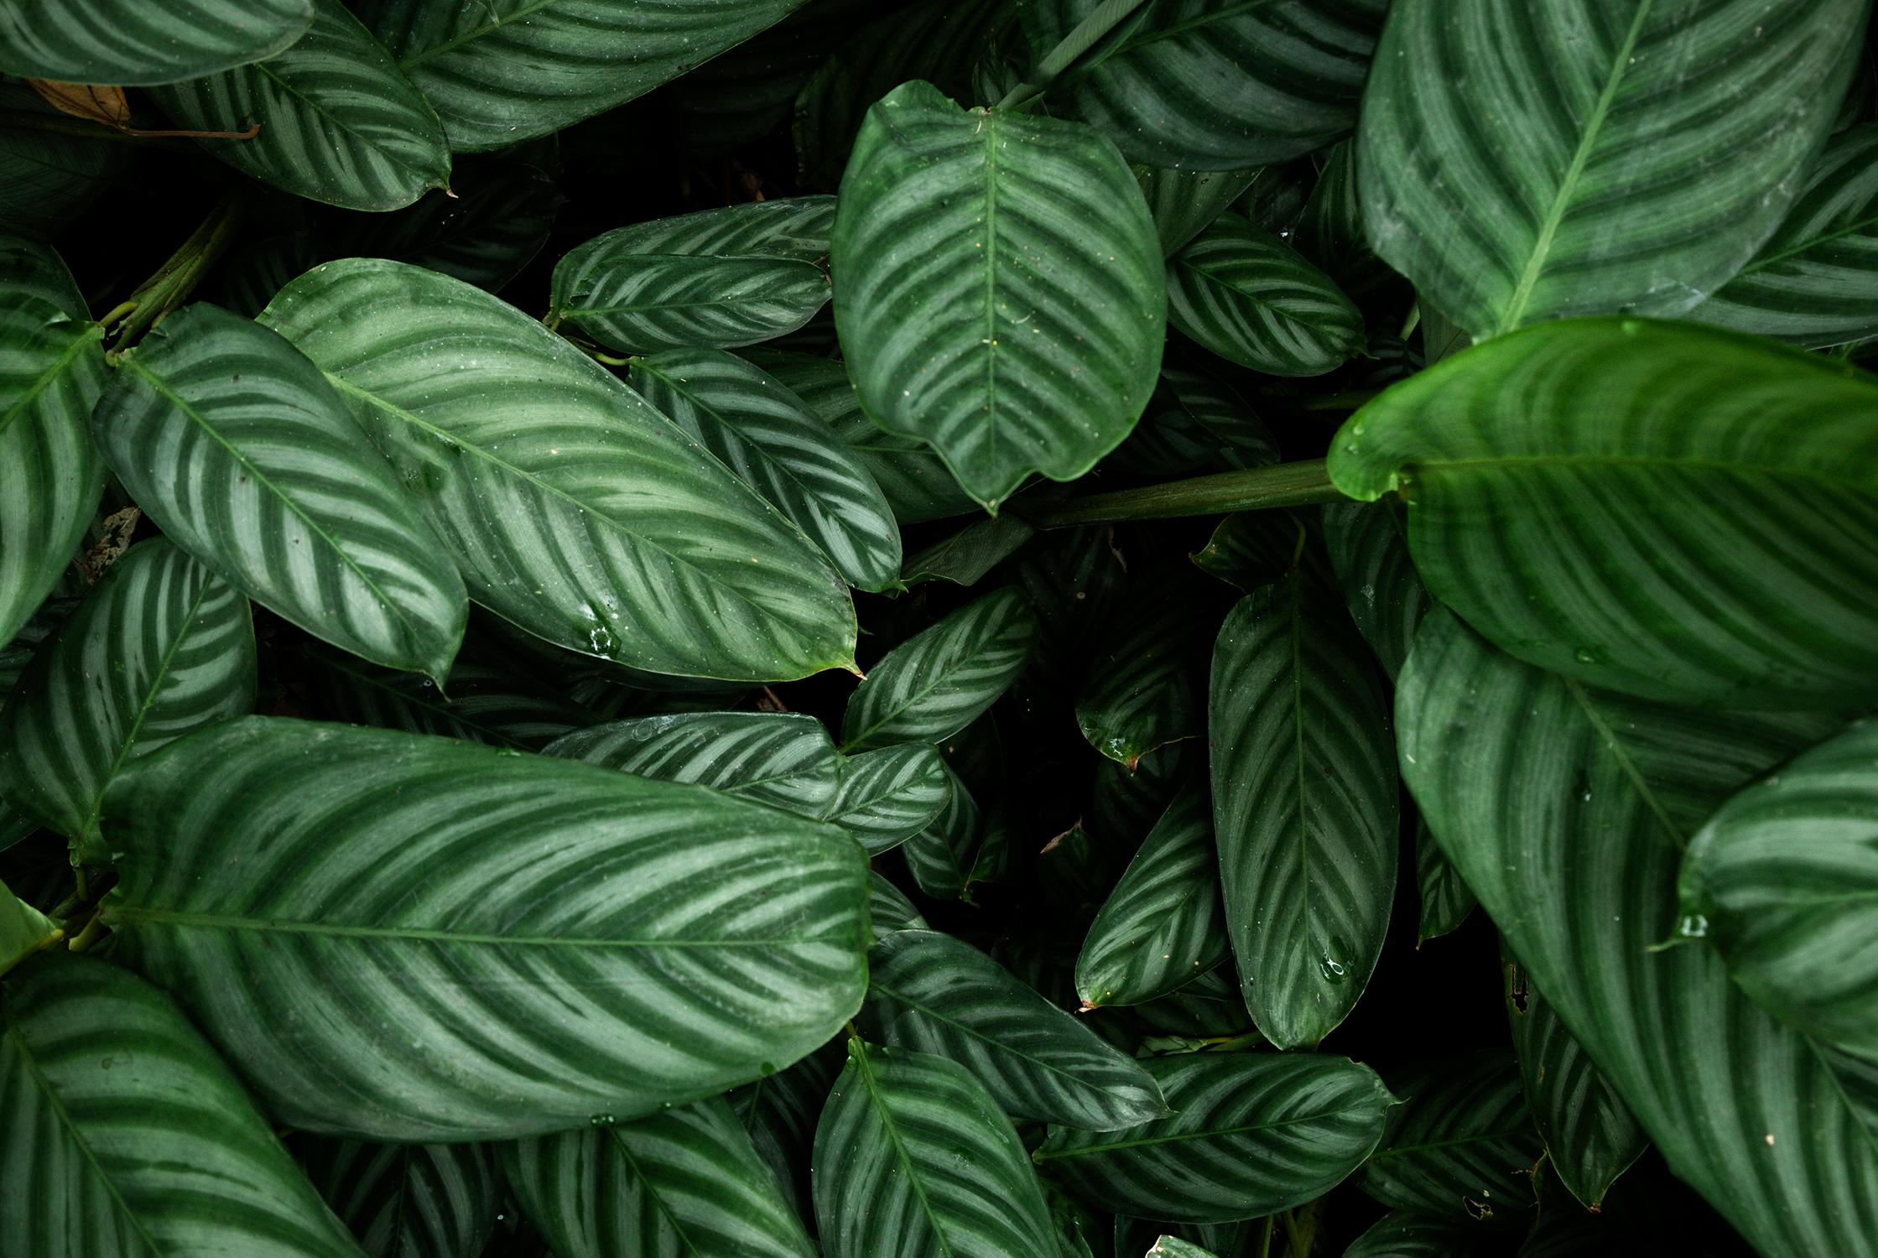
Table of Contents
Problem Statement
Solution
Live Demo
Highlights
AND
Prospect

Slide 3
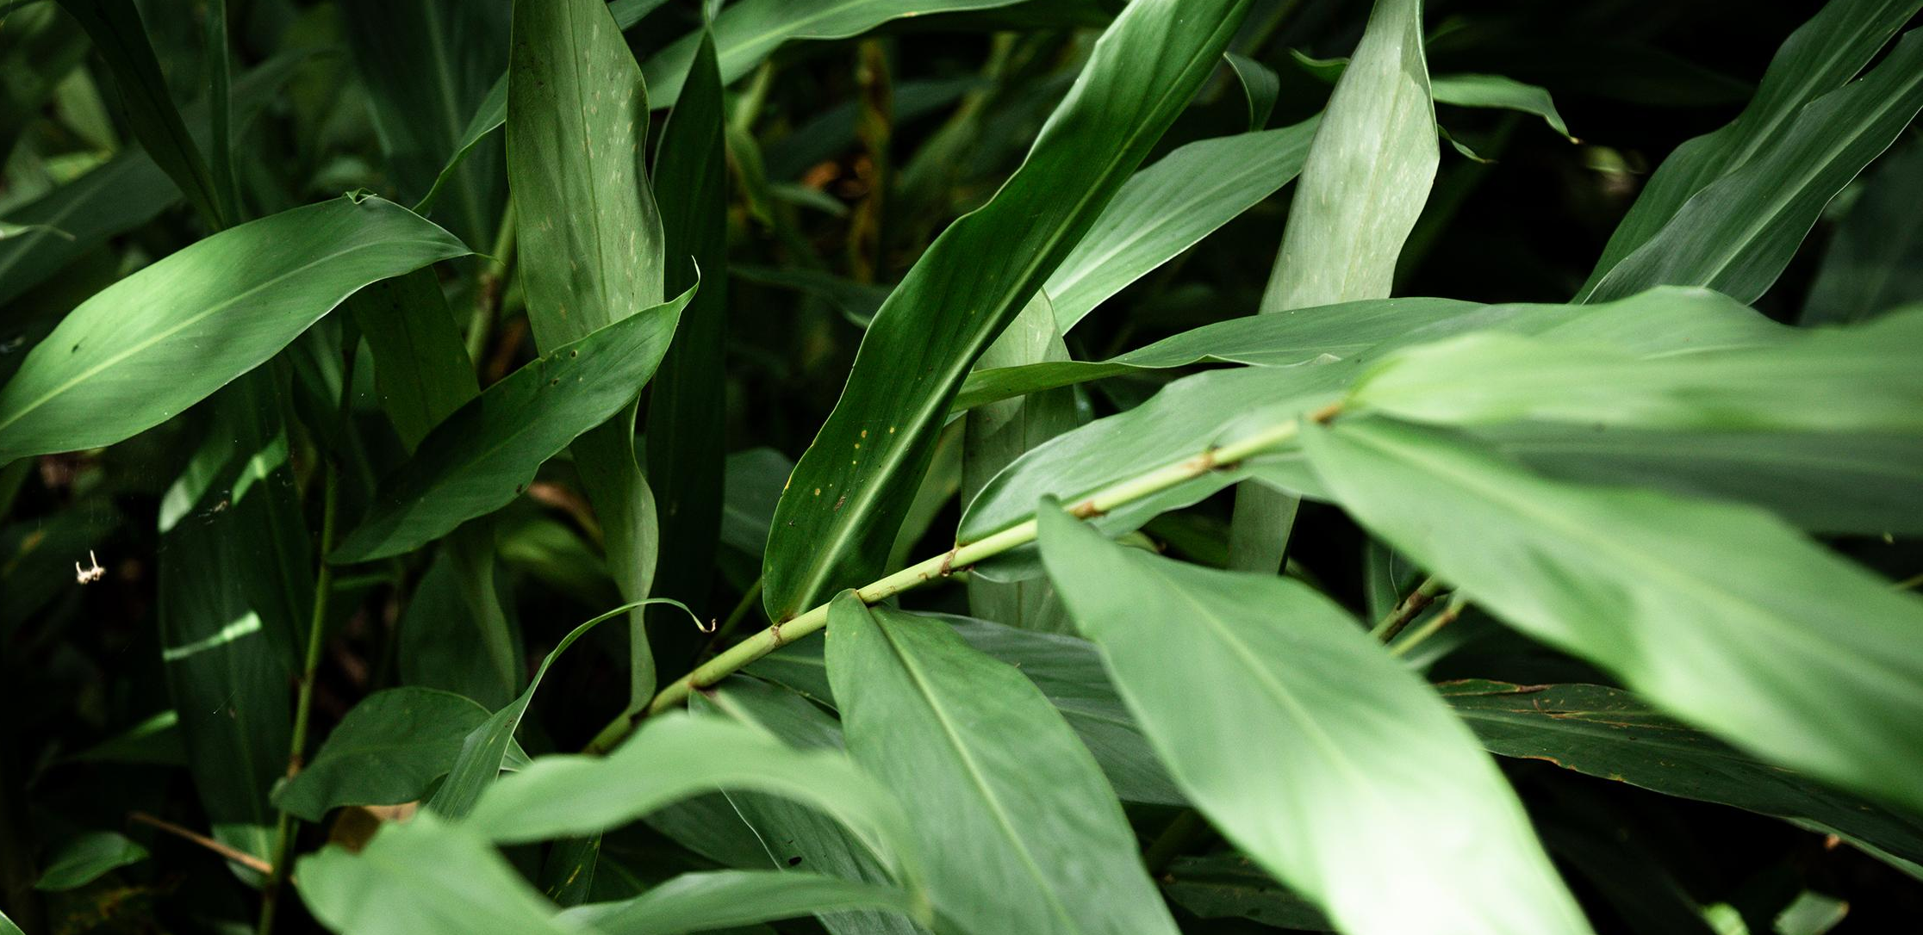
Problem Statement
A virtual representation of the real forest, allowing monitoring and analyzing from distance.
Stakeholder: Environmental Science Lab & Forest Owner
Purpose: Visualizing important data related to scientific research and decision making.
A forest model that can change automatically according to the modification of the data.
Notes:
A digital twin is a virtual representation of the real world, including physical objects, processes, relationships, and behaviors. Elements of a digital twin include data capture and integration, visualization,
advanced analysis including automation, and information sharing and collaboration. A major challenge of this project includes reconstructing the physical characteristics of forest ecosystems by integrating
measured forest data, hardware, and software to digitally describe forest habitats, meaning creating a virtual forest stand. Forest is an important and complex layer in the global Earth modelling.

Slide 4
Solution – Technical Details
Development Platform: Unity
Terrain Tool
Tree Editor
Programming Language: C#
Data Storage: JSON Files
Parametric modeling instead of manual modeling

Slide 5
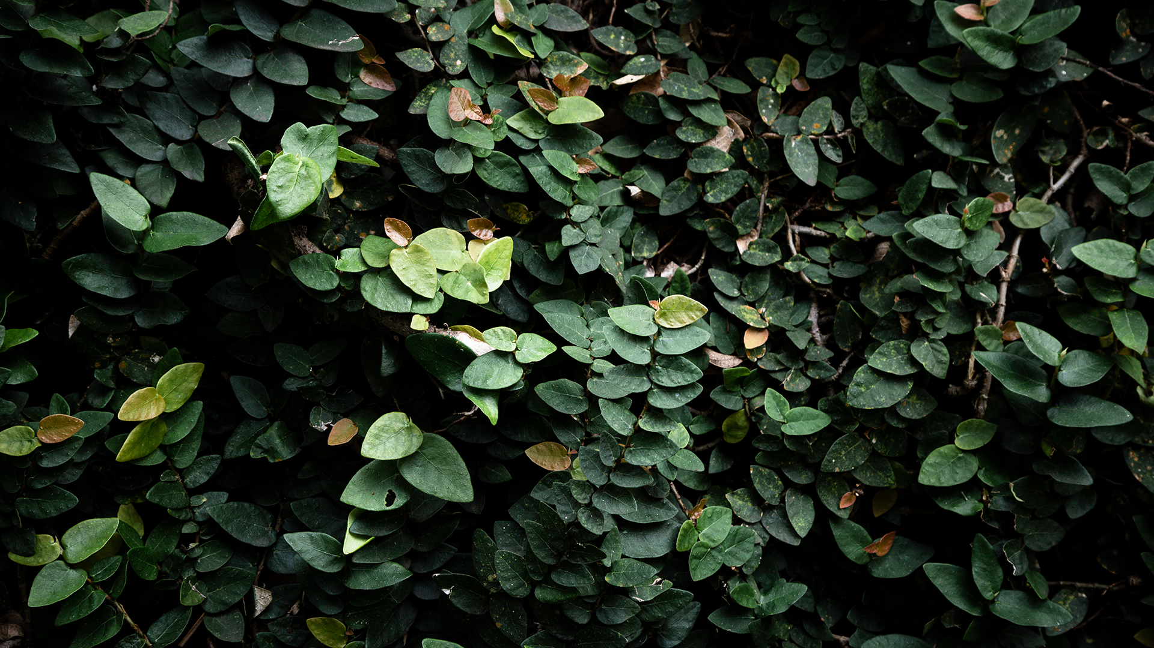
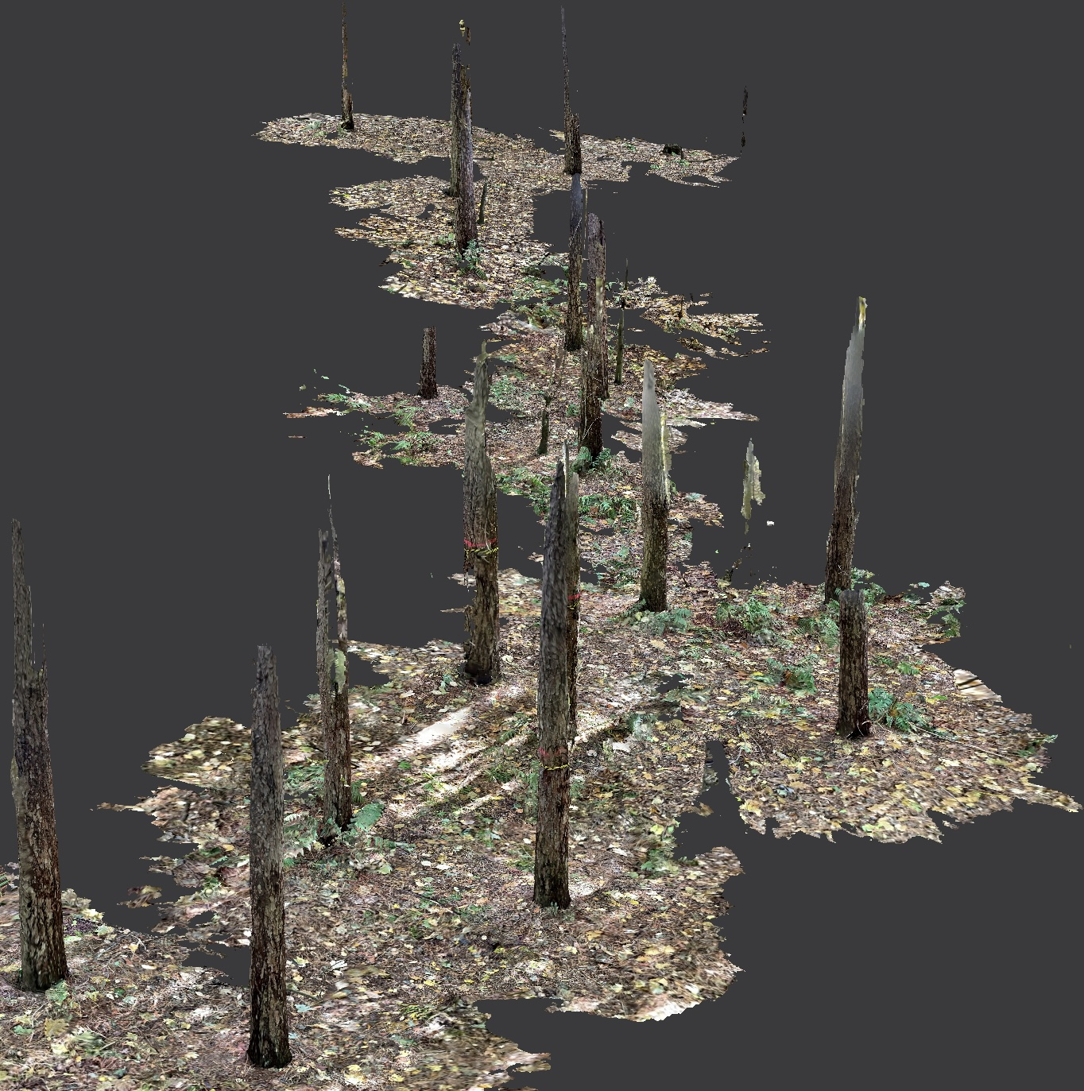
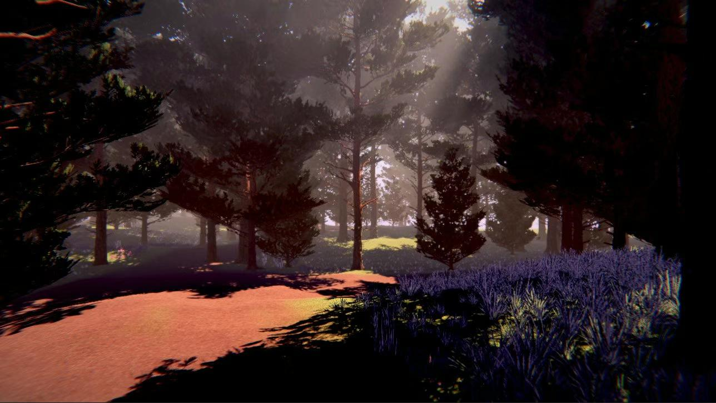
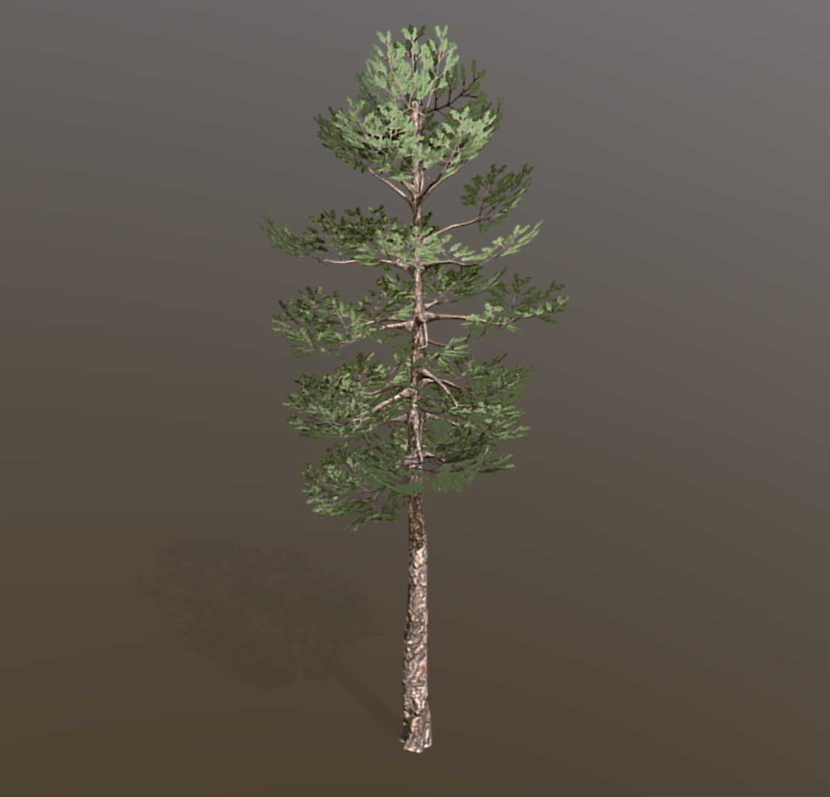
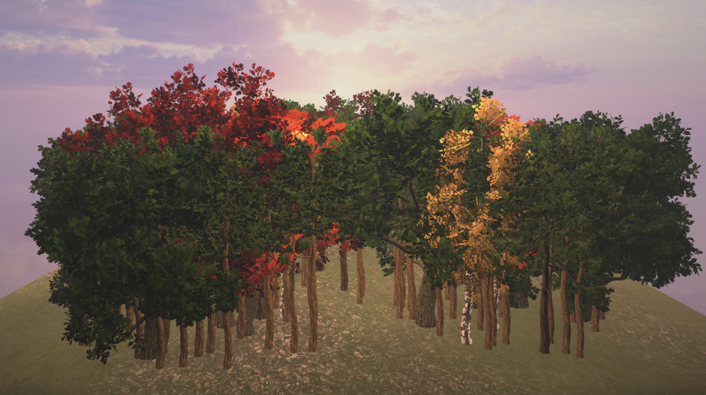
Solution – Tree Models
Phase 01
Phase 02
Phase 03
Phase 04
3D scanning by LiDAR
High quality and precision tree models
Models from Sketchfab
Current models support unity features
Notes:
Tree Model Reuse

Slide 6
Solution – Tree Planting
Phase 01
Phase 02
Phase 03
LiDAR Scanning
Manual Tree Planting with Unity Terrain Tool
Automatic Tree Planting using C# Scripts

Slide 7
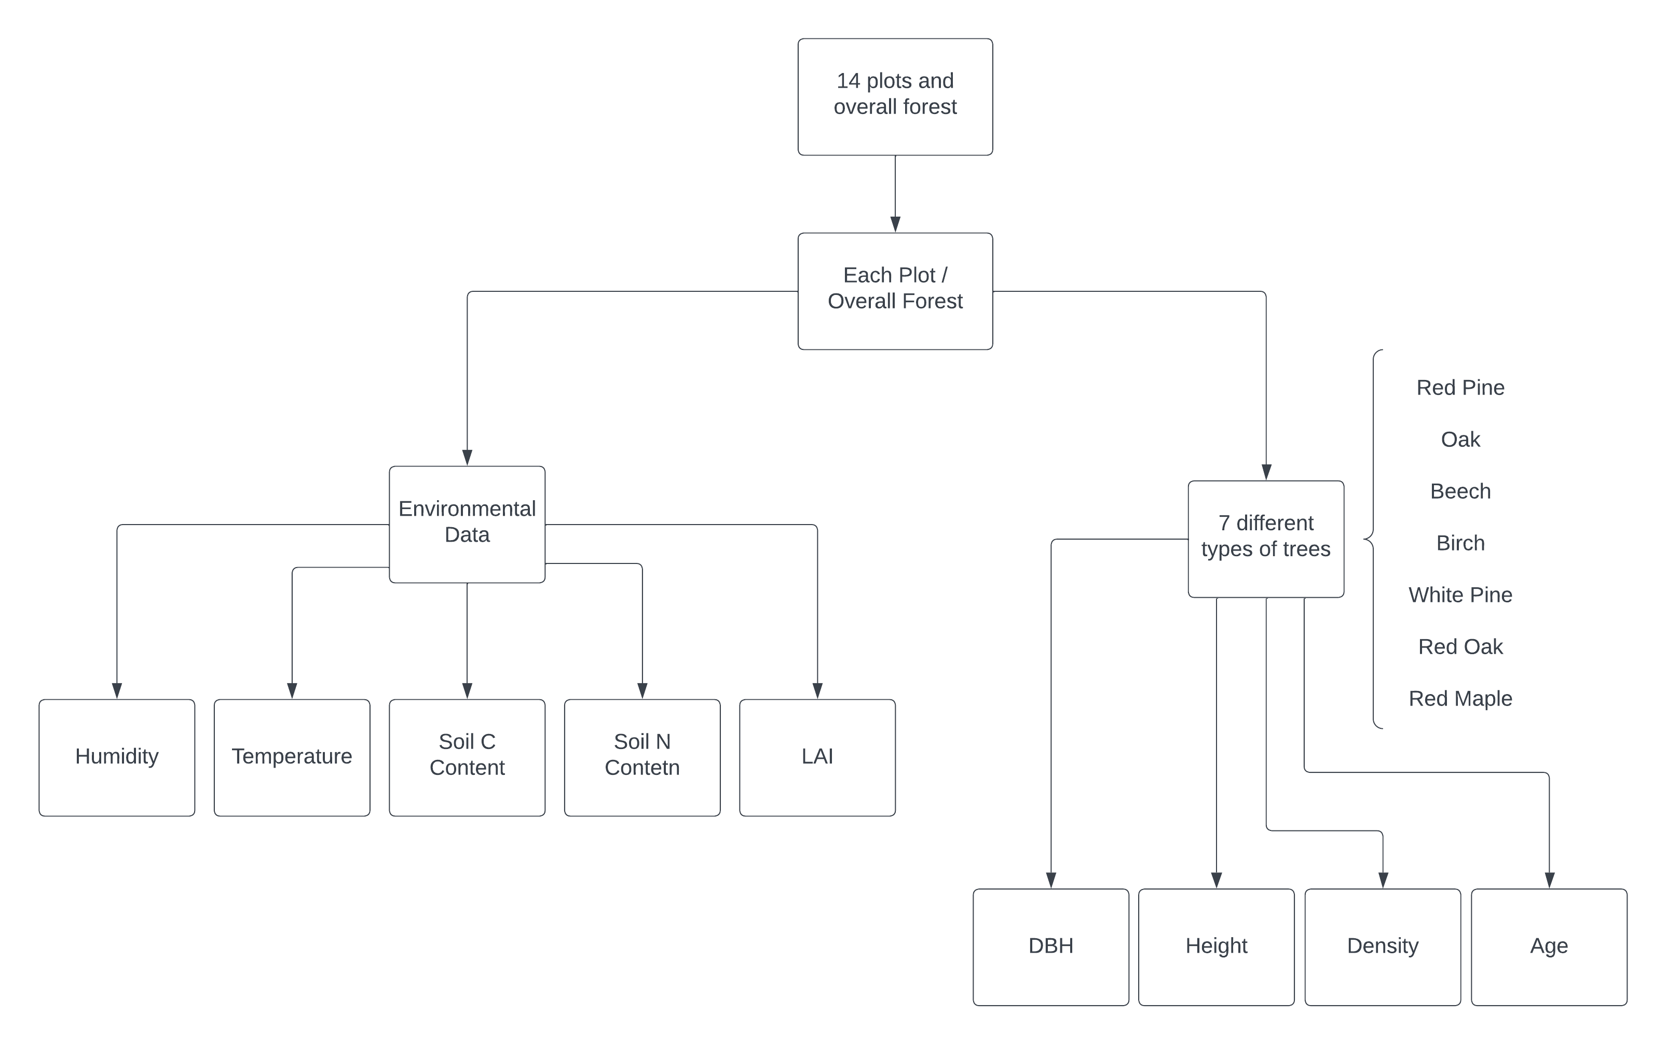
Solution – Data Hierarchy

Slide 8
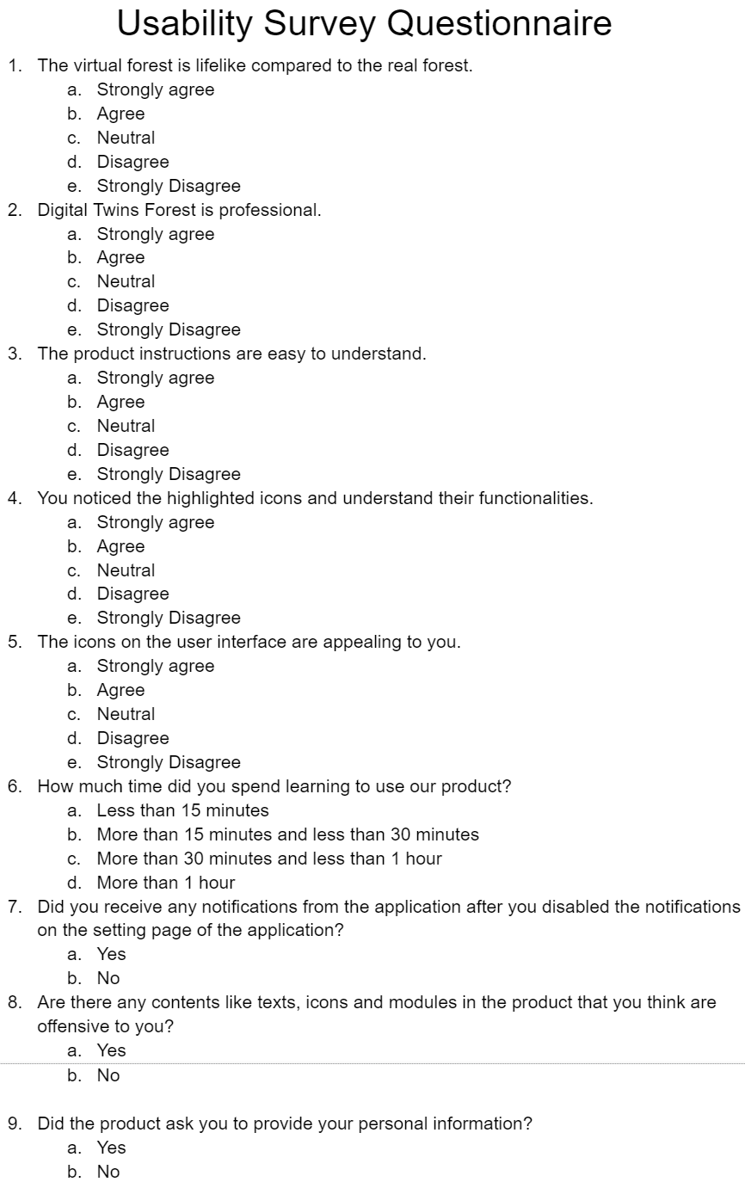
Usability Testing
Usability Testing with Random Users (using questionnaire)
Usability Testing with Scientific Researchers (using interview)

Slide 9
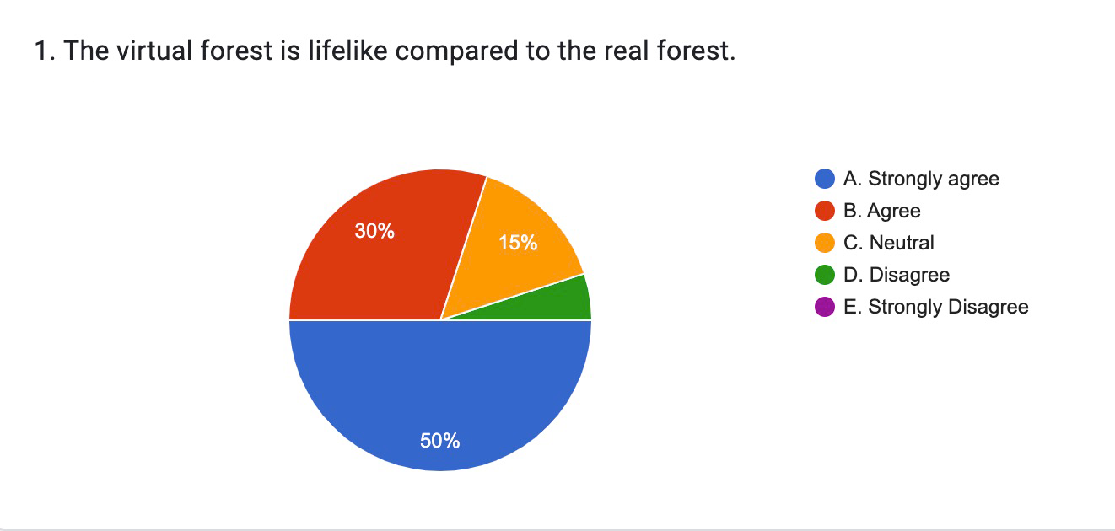
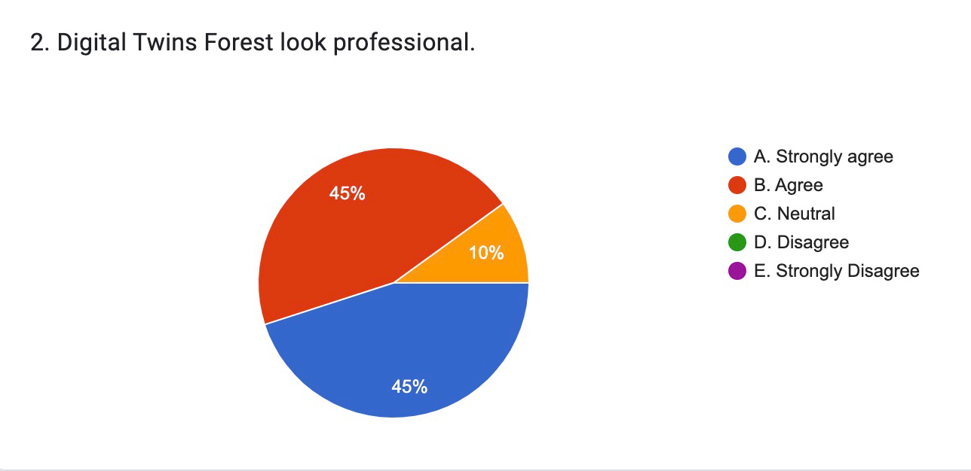
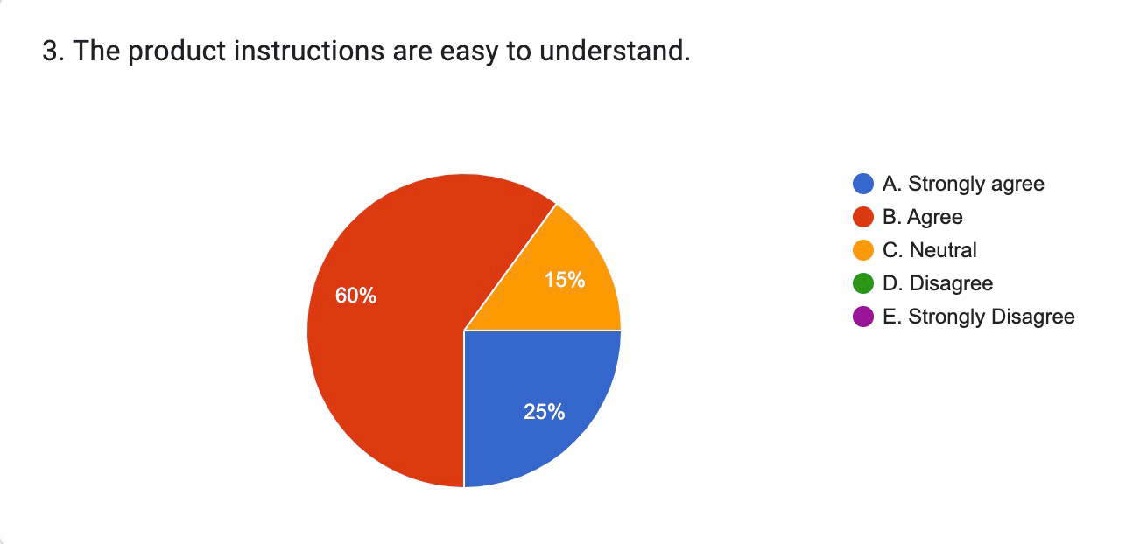
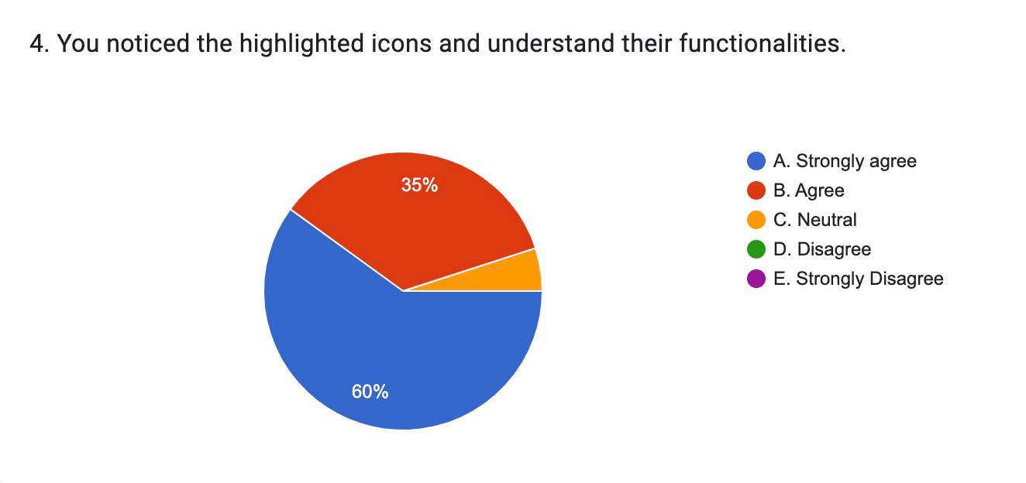
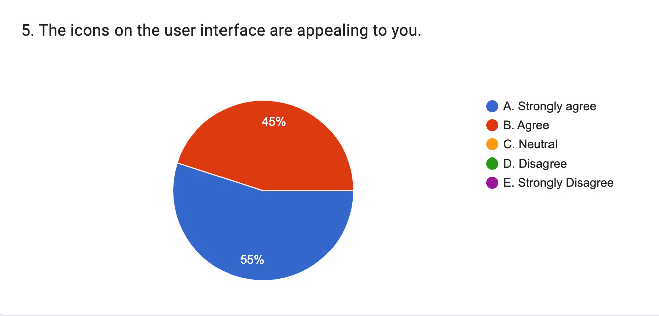
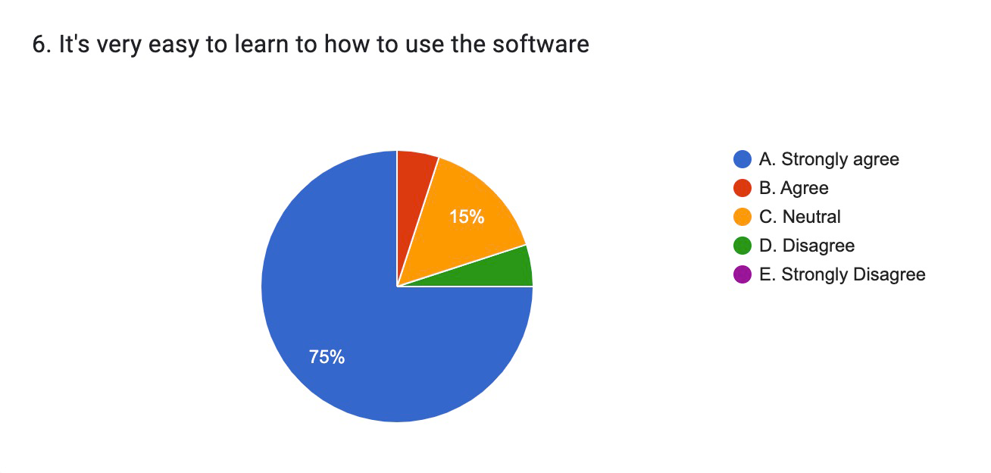
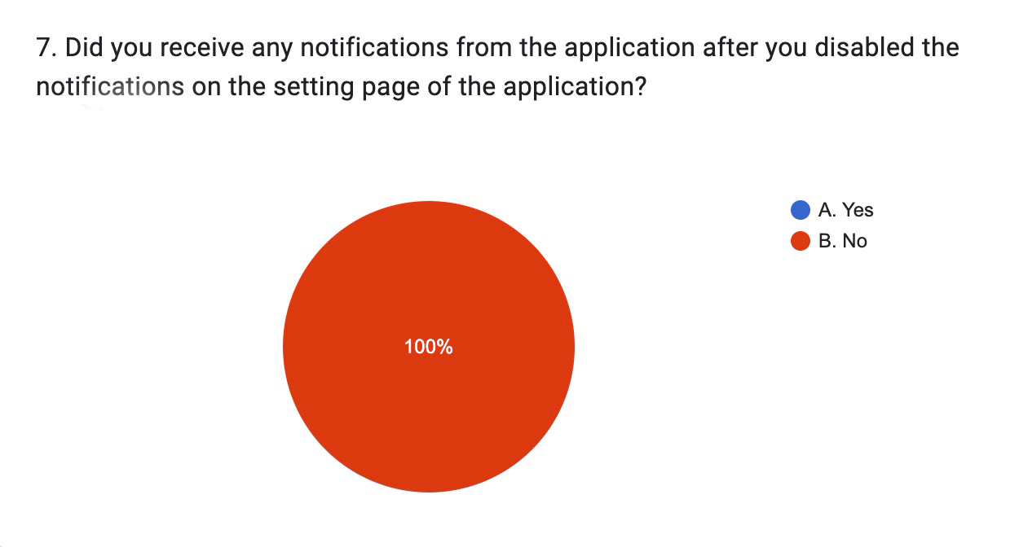
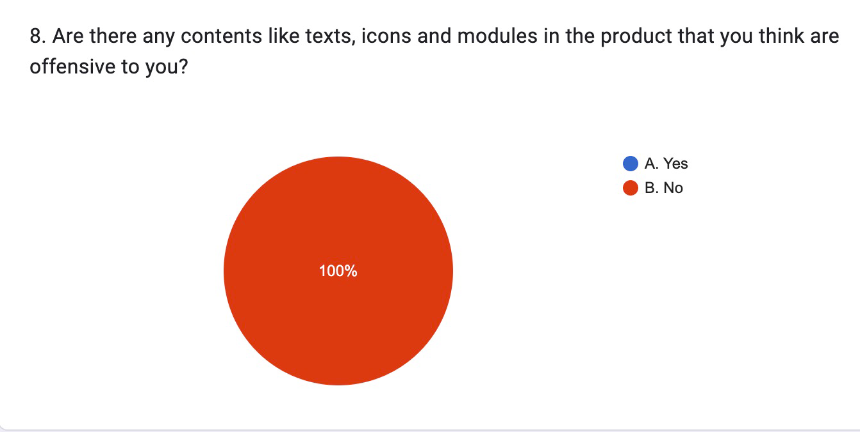
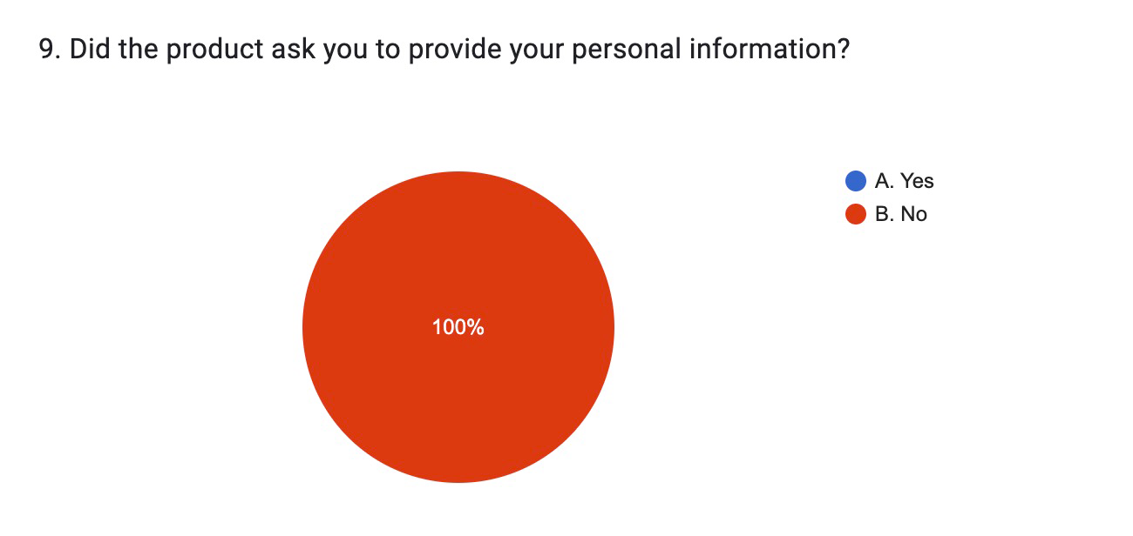
Results from questionnaires

Slide 10
Results from the interview
Adjust the initial position of the camera
Design an interface for leaf information
Seasonal Change
The same distribution of trees as the real forest

Slide 11

Live Demo!

Slide 12
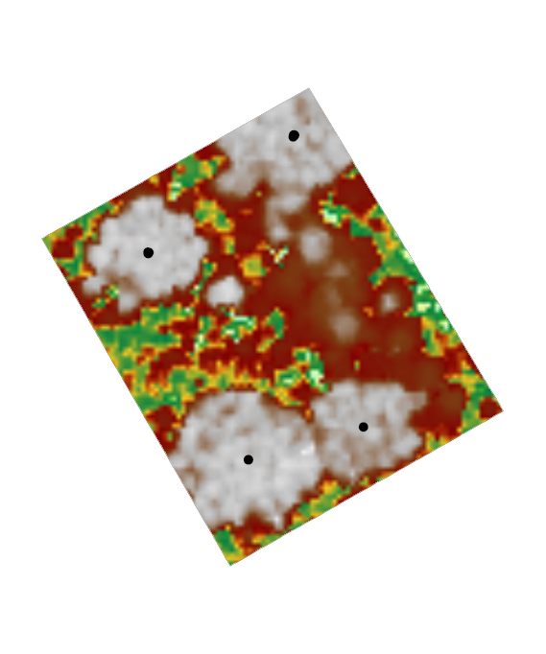
Sample Plot Distribution (Plot 3)
(0, 0)
x
(14, 10) R = 17
(73, 18) R = 15
(77, 78) R = 21
(43, 84) R = 13
y

Slide 13
Challenges & Highlights
Difference from Urban Digital Twin
Static Modeling vs. Dynamic Modeling
Challenges Overcame
Parametric Modeling
Optimized Unity Terrain Tool
Model Reuse and Storage Optimization (We reduced Unity Package from 2.73 G to 1.36 G)

Slide 14
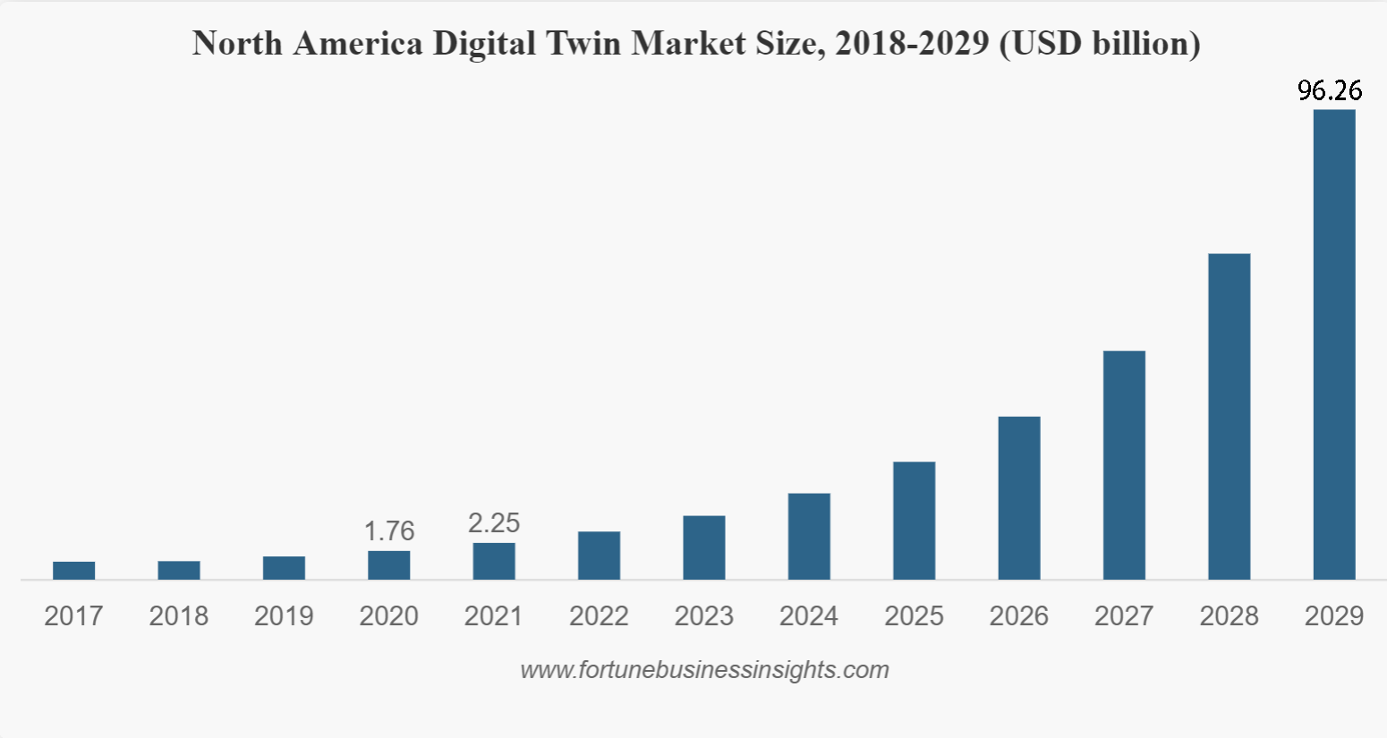
Prospect
Market Value
Digital Twin Forest -> Digital Twin Earth

Slide 15
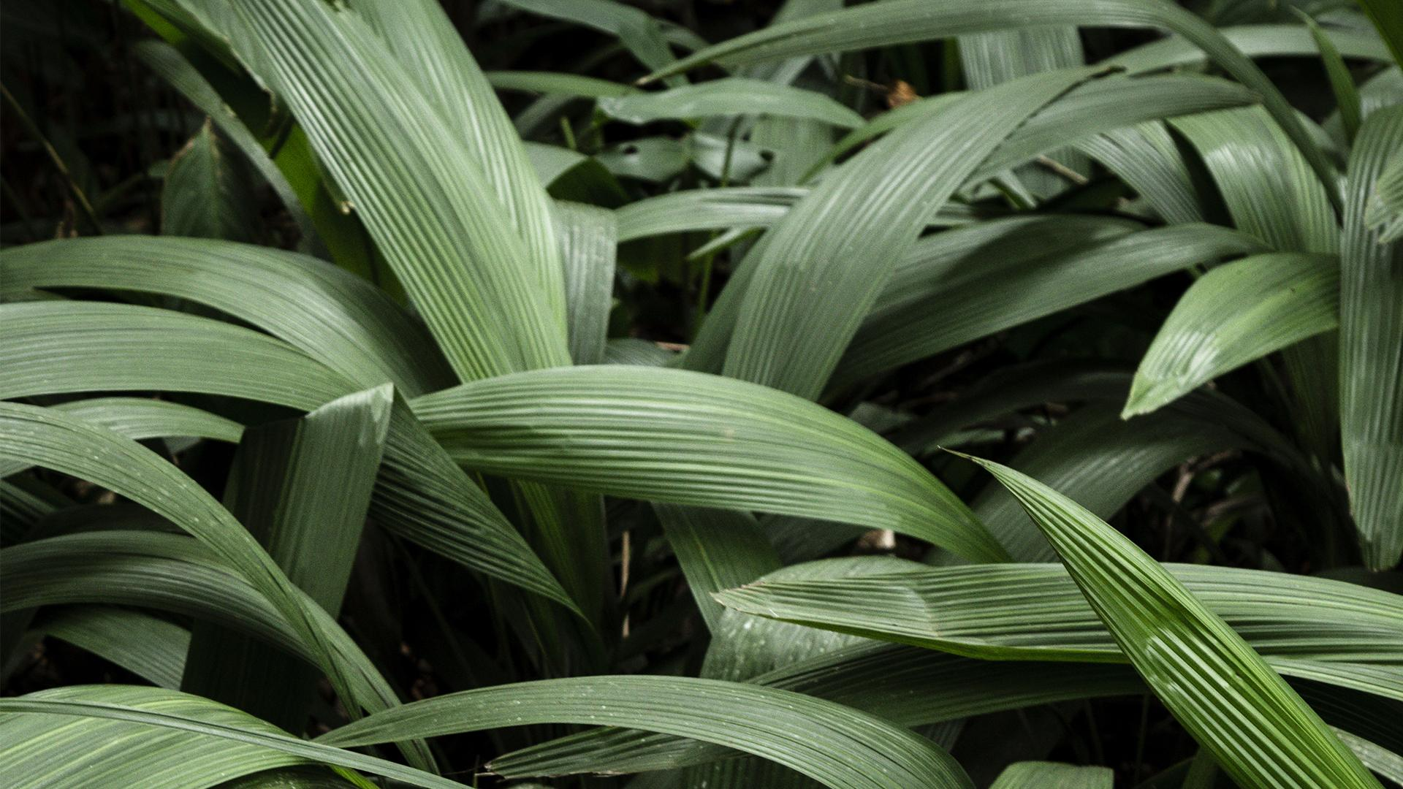

Thank You!

